Slide 1
PFAS Incineration: Simulation and ML to Predict Products’ Partition Coefficient
Duncan Soiffer, Tuomas Pyorre, David Kenney, Andrew Teixeira
October 7, 2023

Slide 2
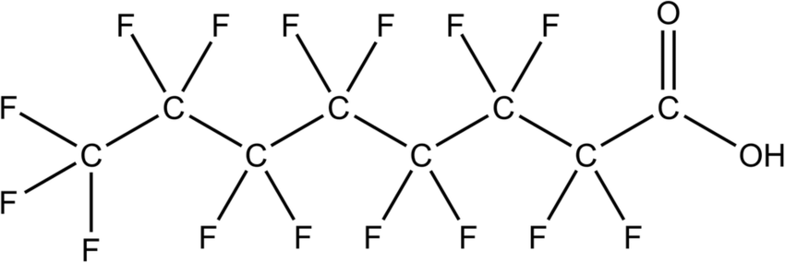
What are PFAS?
Per- and polyfluoroalkyl substances
Central carbon chain surrounded by fluorine
Very stable thermally, chemically, biologically [1]
Hydrophobic and lipophobic [2]
Structure of PFOA

Slide 3
What are PFAS used for?
Non-stick cookware
Food packaging
Water-repellant clothing
Fire suppressants
Many industries
Automotive
Personal care products
Electronic devices
And more… [1]
[1] Glüge et al. “Overview of the uses of PFAS,” Env Sci Processes & Impacts, 2020.

Slide 4
PFAS Pollution
Widespread pollution in soil, water, and animals [3]
In humans, PFAS buildup can:
Disrupt thyroid function
Contribute to liver disease
Lead to pregnancy complications
Degrade immune function [5]
In >97% Americans [4]

Slide 5
PFAS Destruction
PFAS destruction is limited largely to incineration [3]
Products and side effects are poorly understood
Research constrained by high cost and difficulty in measuring products [6]
Products of incomplete combustion are of significant concern [3]
This poses a challenge for remediation efforts

Slide 6
Two-Part Approach
Simulating PFAS Incineration
Augmenting Previous MF-LOGP Model
Create Input Files
Train ML models
Reaction Mechanism Generator
feed product species
Augmented LogP Model
Analyze Output
predict LogP

Slide 7
Simulating PFAS Incineration
Simulation done with RMG [7 8 9]
PFOA studied
Three gas-phase environments
Inert pyrolysis (PFOA only)
Oxidative pyrolysis (with O₂)
Reductive pyrolysis (with H₂)
Select initial conditions
Termination criteria: 90% PFOA eliminated
Simulation done with Reaction Mechanism Generator (RMG)
PFOA studied
Comparison with other research
Create input files
Initial conditions
1080°C
1 bar
90% gas
10% PFOA (100% if inert)
Inert pyrolysis
Reduction
Oxidation
H₂
O₂
Notes:
To perform simulations, the open-source software package Reaction Mechanism Generator (RMG) is used, which is developed in the William H. Green research group in the Department of Chemical Engineering at MIT and in the Richard H. West research group at the Department of Chemical engineering at Northeastern University. RMG uses a general understanding of how molecules react to automatically construct kinetic models that are composed of elementary chemical reaction steps [23], [24], [25]. By automatically generating reaction mechanisms, RMG significantly reduces the time required to create detailed kinetic models [23]. For the purpose of comparison and validation with previous research, this study focuses on the incineration of a single compound in the PFAS family: Perfluorooctanoic acid (PFOA). The reaction mechanisms of three gas-phase incineration environments were studied: oxidative pyrolysis (PFOA in the presence of oxygen), reductive pyrolysis (PFOA in the presence of hydrogen), and inert pyrolysis (PFOA only).

Slide 8
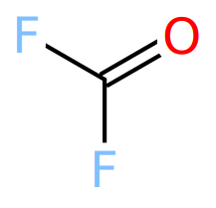
Reactant 2 (Oxygen)
Reactant 1 (PFOA)
Primary Product (Highly Toxic!)
Notes:
Extremely complex behavior from just two reactants! About a third of species shown, and a ¼ of reactions.
The reaction pathways exhibited are consistent with those observed in other research on PFAS incineration, including chain-shortening via carbonyl intermediates, the formation of CF2 and CF3 radicals, and the production of CnFn species and other PICs. However, there is no significant formation of hydrogen fluoride (HF) in our simulations. CARBONYL FLUORIDE

Slide 9
Next Step: Predict Physical Properties
Predicting partition coefficient
Here, refers to n-octanol water partition coefficient (P_{ow,n})
Measures affinity to water vs affinity to octanol [10]
Take logarithm, abbreviate LogP
$$LogP=\log_{10}\left(P_{ow,n}\right)=\log_{10}\left(\frac{{\left[solute\right]}^{n−octanol}}{{\left[solute\right]}^{water}}\right)$$
high LogP
low LogP
LogP is important in determining environmental fate:
Readily absorbed by organics
Easily disperses in environment
[10]

Slide 10
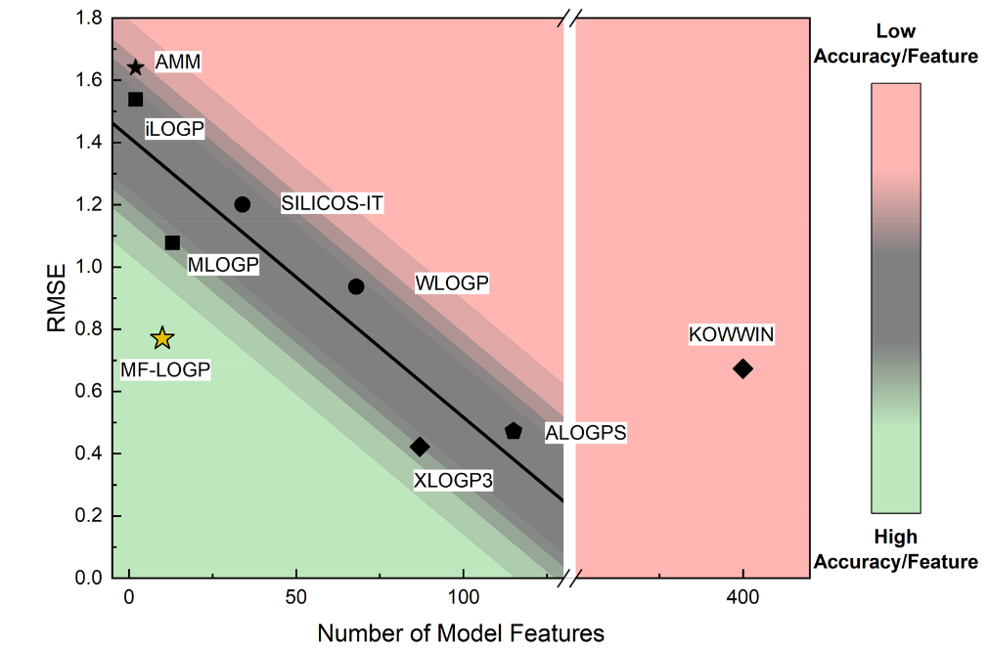
Previous LogP Model: MF-LOGP
MF-LOGP is an in-house ML model by Kenney et al. [10]
Trained/tested on curated dataset of 18,091 experimental LogP values for organic compounds
Uses Random Forest Regression
Achieves comparable performance to some other top structural models
Only considers atomic composition (“structure-agnostic”)

Slide 11
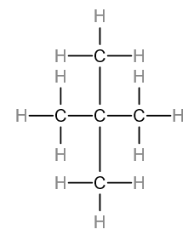
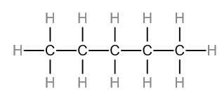
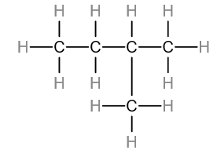
Why Structure-Agnostic?
Sometimes only atomic composition is known
Particularly in complex real-world environments [10]
Molecules with the same atomic composition can differ in structure:
C₅H₁₂
n-Pentane
Isopentane
Neopentane
[10] Kenney et al., “Dimensionally reduced machine learning model for predicting single component octanol–water partition coefficients,” J of Cheminformatics, 2023.
Notes:
In scenarios with many many different products, like over 100, there usually are not methods of accurately determining everything about the products, and molecular structure is sometimes sacrificed in order to gain broader or more accurate knowledge. In taking a model from theoretical simulations, where everything is known, to practice, it is necessary to be robust enough to handle this loss of information, which structural models cannot do.
Examples: analysis of a complex mixture using mass spectrometry methods such as Matrix Assisted Laser Desorption Ionization [32] or Fourier Transform Ion Cyclotron Resonance Mass Spectroscopy (FT-ICR-MS)

Slide 12
Novelties Compared to MF-LOGP
From MF-LOGP data, 15% reserved for final testing
1,086 new experimental points from [11] added
Train-validation split: 85/15
All training data duplicated, small noise added to LogP
Features Selected: # each atom % by atom
Previous model: MF-LOGP
Add new
LogP data
Augmented LogP model
Train new ML models
Notes:
15% reserved for final testing, fair comparison with MF-LOGP
n = 15,420 + 1,086
Trained with 85/15 split: 14,030 training points, 2,476 validation
Training data were duplicated with noise added to duplicated LogP values, this imputed data increases robustness against overfitting.
While the total number of atoms and molecular weight seem like reasonable physical properties to include as features, they are linearly dependent on other features selected for inclusion (# of each atom) and we find that, in practice, they harm model performance

Slide 13
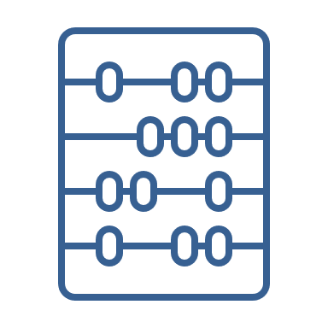
Improvements in Architecture and Tuning
Previous model: MF-LOGP
Architecture selection, tuning
Further Developed:
Random Forest Regression (RFR)
Gradient Boosting Regression (GBR)
K-Nearest Neighbors (KNN)
Linearly Corrected KNN (LCKNN)
10 models tested,
4 models chosen
Add new
LogP data
Tuning: 1. Random Search
2. Iterative Grid Search 3. KNN developed into LCKNN
Additionally, models remember data distribution, scale to Gaussian
Augmented LogP model
Train new ML models
Notes:
Random Search to determine preliminary hyperparameters. Grid Search iteratively performed in neighborhood of preliminary values LCKNN developed: ridge regression is used to push KNN in (likely) correct direction based off differences between molecule and its k neighbors

Slide 14
Performance Comparison
Model | RMSE
 | Train | Validation
RFR | .469 | .750
GBR | .483 | .723
KNN | .467 | .770
LCKNN | .467 | .753
GBR is least prone to overfitting, selected as model for final evaluation
Notes:
RMSE = root mean squared error, MAE = mean absolute error, R² = correlation coefficient
GBR worse training error but better testing, least prone to overfitting

Slide 15
Final Testing Performance
Model | RMSE | MAE | R²
GBR | .67 | .44 | .87
MF-LOGP | .77 | .52 | .83
XLOGP3* | .42 | .09 | .95
*high accuracy structural LogP model [11]. MF-LOGP and XLOGP3 errors from [10]
Closes gap between MF-LOGP and XLOGP3’s error by 28%, 19%, and 33%, respectively.
To our knowledge, this is the best performing structure-agnostic LogP model in the field.

Slide 16
Applying the Model: Revealing Product Distributions under Reactive Conditions
Reduction in LogP observed in all treatments
Strongest effect in oxidative: -2.1 mean LogP
Notes:
Lists of product species from completed simulations were fed to the developed ML model to predict their LogP values.
Violin plot weighted by molar fraction. PFOA’s predicted LogP shown in dashed red line, weighted mean is blue line, weighted median is green line.

Slide 17
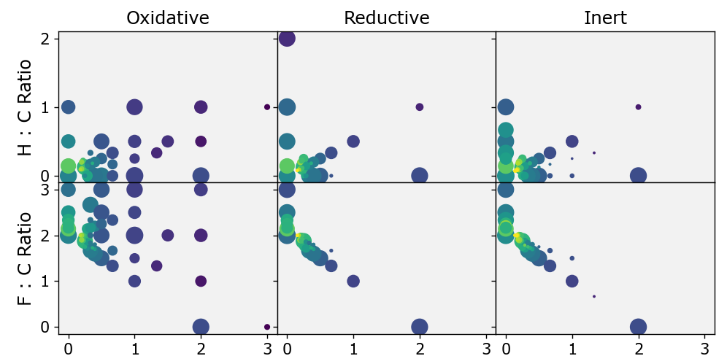
Diving Deeper…
LogP
PFOA
Hydrogenation
Deoxygenation
Oxidation
CO₂
Dehydration
Demethylation
PFOA
Dehydrogenation
O : C Ratio
Notes:
The area of each point is directly proportional to the log of the total molar fraction of each product at that point
t much of the reduction in LogP is a result of oxidation and hydrogenation. The removal of CF3 (defluoromethylation) also drives LogP values lower by decreasing the central C-F chain length of the PFAS.
Paradoxically, an increase in F:C ratio also correlates with a decrease in LogP. This is because as the chain length of a PFAS increases, its fluorine to carbon ratio approaches 2. Above 2, an increase in F:C ratio can actually represent defluorination as the molecule’s central chain breaks apart, pushing the C:F ratio higher.

Slide 18
Uncovering The Secrets Behind PFAS Incineration
Gained broader physical understanding of the products of PFAS incineration, observed lower LogP in products.
In the process, created improved structure-agnostic machine learning model for LogP prediction.
Demonstrated effective coupling between simulation and predictive machine learning.
Notes:
Applied to PFOA incineration simulations, we observe lowered LogP in all treatments To our knowledge, this is the first time LogP has been studied for PFAS incineration. Broader physical understanding of products.
Enhanced structure-agnostic ML model for predicting LogP is developed, best in field to our knowledge.
Simulations not necessarily reflective of reality, but reveal at least potential to combust into dangerous compounds with low LogP.

Slide 19
Acknowledgements
Thank you to NSF for funding this research under REU Site Grant #1852498
The members of the WPI Dynamics Lab, where this research took place, for providing a supportive atmosphere!
Creators of RMG:
William H. Green research group at MIT
Richard H. West research group at Northeastern University
Further questions? Contact: dssoiffer@wpi.edu

Slide 20
Future Work
Other treatment methods
E.g., hydrothermal liquefaction
Varying initial conditions
Different PFAS
Further model improvements
More data, more diverse molecules
Architecture exploration

Slide 21
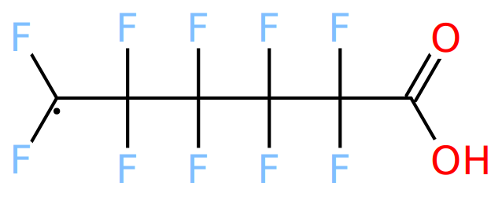
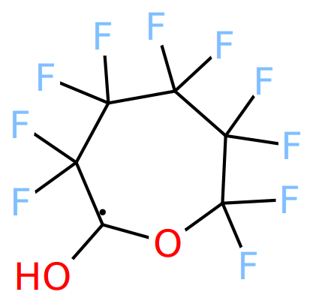
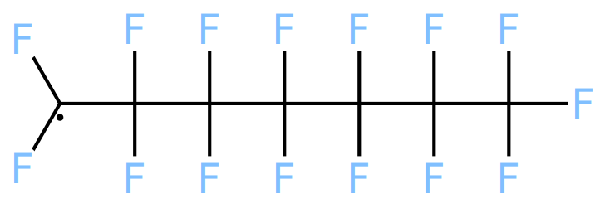
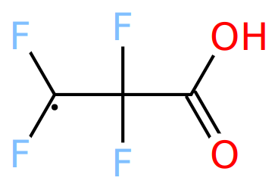
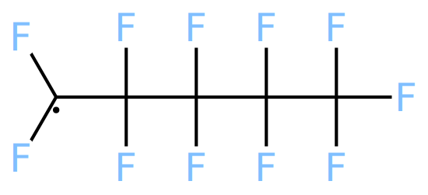
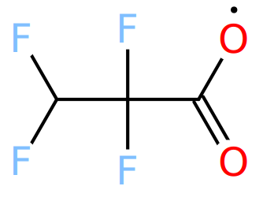
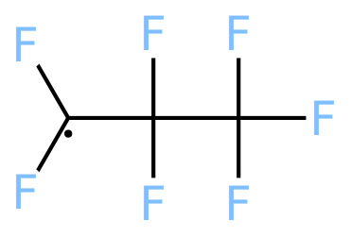
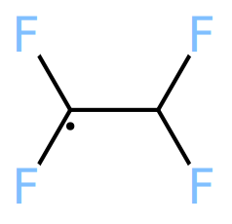
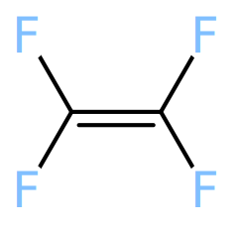
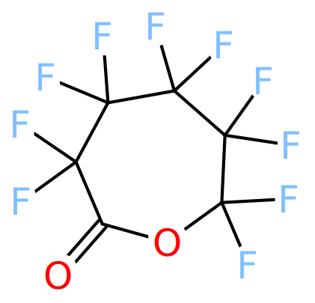
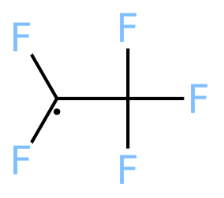
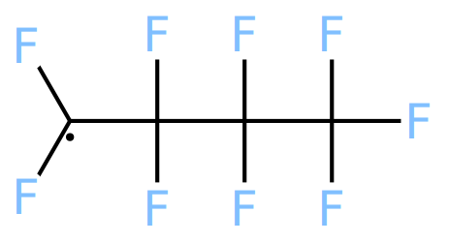
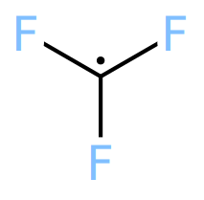
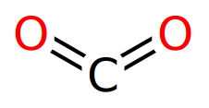
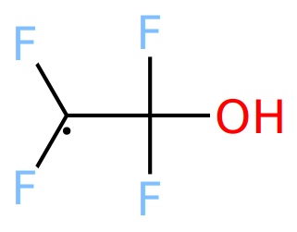
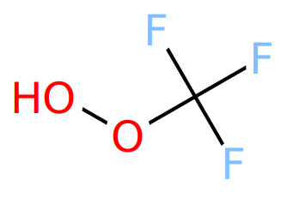
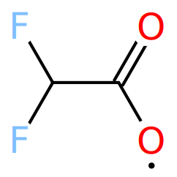
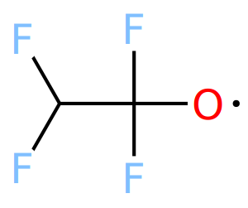
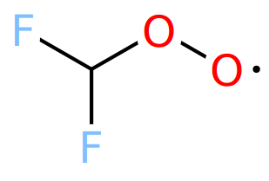
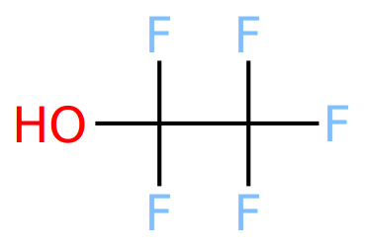
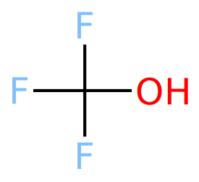
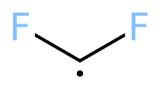
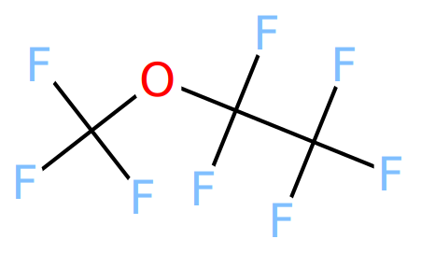
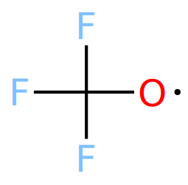
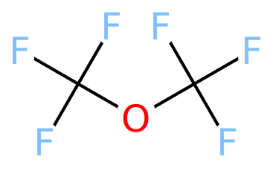
Primary Products of Simulated Reactions
Reaction | Total Species | Primary Products (molar fraction)*
Oxidative | 102 | CF₂O (.41) | C₂F₄ (.16) | CO₂ (.14)
Reductive | 76 | C₂H₂F₄ (.28) | CO₂ (.15) | CHF₃ (.14)
Inert | 110 | C₂F₄ (.36) | CO₂ (.19) | C₂HF₅ (.09)
*excluding excess reactants
Extremely complex behavior from just two reactants
Primary product (highly toxic)
Notes:
All reaction types emit carbon dioxide (CO2) as one of their three most abundant products by molar fraction, corresponding to the removal of PFOA’s head group. The reaction pathways exhibited are consistent with those observed in other research on PFAS incineration, including chain-shortening via carbonyl intermediates, the formation of CF2 and CF3 radicals, and the production of CnFn species and other PICs. However, there is no significant formation of hydrogen fluoride (HF) in our simulations.

Slide 22
Full Performance Comparison
Model | RMSE |  | MAE |  | R²
 | Train | Test | Train | Test | Train | Test
RFR | .469 | .750 | .286 | .469 | .938 | .841
GBR | .483 | .723 | .307 | .461 | .934 | .852
KNN | .467 | .770 | .275 | .470 | .938 | .833
LCKNN | .467 | .753 | .275 | .465 | .938 | .836
Notes:
RMSE = root mean squared error, MAE = mean absolute error, R² = correlation coefficient
GBR worse training error but better testing, least prone to overfitting

Slide 23
Model Selection
10 models considered
Linear, Lasso, & Ridge Regression, K-nearest Neighbors (KNN), custom Linearly Corrected KNN (LCKNN), Random Forest Regression (RFR), Gradient Boosting Regression (GBR), Histogram-based Gradient Boosting Regression (HGBR), and 3 and 4-layer feed-forward fully-connected neural networks
After initial tuning, RFR, GBR, KNN, and LCKNN selected for further development

Slide 24
Atoms Considered
Carbon, Hydrogen, Nitrogen, Oxygen, Sulfur, Phosphorus, Fluorine, Chlorine, Bromine, Iodine

Slide 25
Augmenting MF-LOGP: Model Tuning
Random Search to determine preliminary hyperparameters
Grid Search iteratively performed in neighborhood of preliminary values
KNN further modified
LCKNN developed: ridge regression is used to push KNN in (likely) correct direction based off differences between molecule and its k neighbors

Slide 26
Augmenting MF-LOGP: Data
15% of data reserved for final testing
n = 2,722 testing points
New experimental LogP data added to remaining 85%
n = 15,420 + 1,086
Trained with 85/15 split: 14,030 training points, 2,476 validation
Training data were duplicated with noise added to duplicated LogP values, increasing robustness against overfitting
Feature selection
Number of each atom, % composition by atom

